Slide 1


Video Games
Analysis on video games sales

Slide 2

Introduction
Steam is an online platform from game developer Valve
Where you can buy, play, create, and discuss PC games.
The platform hosts thousands of games (as well as downloadable content, or DLC, and user-generated features called "mods") from major developers and indie game designers alike.

Slide 3
Agenda
To make recommendation on the video games based on
Types of Genre
Game Critic and User Score
Relevant gaming platforms
Top ranking video games
Identifying Top Publishers/Developers

Slide 4
Genre
Action, Sports, Shooter, Role-Playing and Platform are the top 5 Genre, when it comes to sales.
When comparing with average sale, Platform, Shooter, Role-Playing, Racing and Sports are the top 5.
Sports, Shooter, Role-Playing and Platform are performing well in both total and average sale.
Action genre however did not have a high average sale, compare to the rest of the performing top sales genre.

Slide 5
Game Critic and User Score
Role-playing, sports and shooter genres score well on critic score among the top genre sale.
Role-playing, platform and fighting score well on user score.
The top 3 genre in total sale did not score well in user score.

Slide 6
Total Sales By Platform

Slide 7
Platform Generation
We are here
PC
PC
There are a good increase in gaming platforms after Gen 4.
There is a steady increase of sales as the platform generation evolves.
Gen 7 has the highest amount of sales generated.
Gen 3 has the highest average sales for video games.
Video game are getting more affordable after Gen 4.

Slide 10
List Of Top 30 Games
Genre | Gametitle | Publisher | Platform | TotalSale
Sports | Wii Sports | Nintendo | Wii | 82.53
Platform | Super Mario Bros. | Nintendo | NES | 40.24
Racing | Mario Kart Wii | Nintendo | Wii | 35.52
Sports | Wii Sports Resort | Nintendo | Wii | 32.77
Role-Playing | Pokemon Red/Pokemon Blue | Nintendo | GB | 31.37
Puzzle | Tetris | Nintendo | GB | 30.26
Platform | New Super Mario Bros. | Nintendo | DS | 29.8
Misc | Wii Play | Nintendo | Wii | 28.92
Platform | New Super Mario Bros. Wii | Nintendo | Wii | 28.32
Shooter | Duck Hunt | Nintendo | NES | 28.31
Simulation | Nintendogs | Nintendo | DS | 24.67
Racing | Mario Kart DS | Nintendo | DS | 23.21
Role-Playing | Pokemon Gold/Pokemon Silver | Nintendo | GB | 23.1
Sports | Wii Fit | Nintendo | Wii | 22.7
Misc | Kinect Adventures! | Microsoft Game Studios | X360 | 21.81
Sports | Wii Fit Plus | Nintendo | Wii | 21.79
Action | Grand Theft Auto V | Take-Two Interactive | PS3 | 21.04
Action | Grand Theft Auto: San Andreas | Take-Two Interactive | PS2 | 20.81
Platform | Super Mario World | Nintendo | SNES | 20.61
Misc | Brain Age: Train Your Brain in Minutes a Day | Nintendo | DS | 20.15
Role-Playing | Pokemon Diamond/Pokemon Pearl | Nintendo | DS | 18.25
Platform | Super Mario Land | Nintendo | GB | 18.14
Platform | Super Mario Bros. 3 | Nintendo | NES | 17.28
Action | Grand Theft Auto V | Take-Two Interactive | X360 | 16.27
Action | Grand Theft Auto: Vice City | Take-Two Interactive | PS2 | 16.15
Role-Playing | Pokemon Ruby/Pokemon Sapphire | Nintendo | GBA | 15.85
Puzzle | Brain Age 2: More Training in Minutes a Day | Nintendo | DS | 15.29
Role-Playing | Pokemon Black/Pokemon White | Nintendo | DS | 15.14
Racing | Gran Turismo 3: A-Spec | Sony Computer Entertainment | PS2 | 14.98
Shooter | Call of Duty: Modern Warfare 3 | Activision | X360 | 14.73

Slide 11
Top 30 Games

Slide 12
List Of Top 10 Games Based On Genre
Genre | Gametitle | Publisher | TotalSale
Action | Grand Theft Auto V | Take-Two Interactive | 56.57
Action | Grand Theft Auto: San Andreas | Take-Two Interactive | 23.84
Action | Grand Theft Auto IV | Take-Two Interactive | 22.39
Action | Grand Theft Auto: Vice City | Take-Two Interactive | 16.19
Action | FIFA Soccer 13 | Electronic Arts | 15.96
Action | LEGO Star Wars: The Complete Saga | LucasArts | 15.26
Action | LEGO Batman: The Videogame | Warner Bros. Interactive Entertainment | 13.39
Action | Grand Theft Auto III | Take-Two Interactive | 13.11
Action | Assassin's Creed III | Ubisoft | 13.02
Action | Assassin's Creed IV: Black Flag | Ubisoft | 13.02
Adventure | Assassin's Creed | Ubisoft | 11.27
Adventure | Super Mario Land 2: 6 Golden Coins | Nintendo | 11.18
Adventure | L.A. Noire | Take-Two Interactive | 5.87
Adventure | Zelda II: The Adventure of Link | Nintendo | 4.38
Adventure | Rugrats: Search For Reptar | THQ | 3.34
Adventure | Club Penguin: Elite Penguin Force | Disney Interactive Studios | 3.14
Adventure | Heavy Rain | Sony Computer Entertainment | 3.03
Adventure | Minecraft: Story Mode | Mojang | 2.91
Adventure | Myst | Red Orb | 2.81
Adventure | Rise of the Tomb Raider | Square Enix | 2.76
Fighting | Super Smash Bros. Brawl | Nintendo | 12.84
Fighting | Super Smash Bros. for Wii U and 3DS | Nintendo | 12.42
Fighting | WWE SmackDown vs Raw 2008 | THQ | 7.39
Fighting | Street Fighter IV | Capcom | 7.23
Fighting | Tekken 3 | Sony Computer Entertainment | 7.16
Fighting | Super Smash Bros. Melee | Nintendo | 7.07
Fighting | Street Fighter II: The World Warrior | Capcom | 6.3
Fighting | Tekken 2 | Sony Computer Entertainment | 5.74
Fighting | Mortal Kombat | Warner Bros. Interactive Entertainment | 5.59
Fighting | Fight Night Round 3 | Electronic Arts | 5.55
Misc | Wii Play | Nintendo | 28.92
Misc | Kinect Adventures! | Microsoft Game Studios | 21.81
Misc | Brain Age: Train Your Brain in Minutes a Day | Nintendo | 20.15
Misc | Guitar Hero III: Legends of Rock | Activision | 16.35
Misc | Just Dance 3 | Ubisoft | 12.76
Misc | Minecraft | Microsoft Game Studios | 12.62
Misc | Guitar Hero: World Tour | Activision | 10
Misc | Just Dance 2 | Ubisoft | 9.44
Misc | Mario Party DS | Nintendo | 8.91
Misc | Just Dance 4 | Ubisoft | 8.74
Platform | Super Mario Bros. | Nintendo | 45.31
Platform | New Super Mario Bros. | Nintendo | 29.8
Platform | New Super Mario Bros. Wii | Nintendo | 28.32
Platform | Super Mario World | Nintendo | 26.07
Platform | Super Mario Bros. 3 | Nintendo | 22.48
Platform | Super Mario 64 | Nintendo | 22.19
Platform | Super Mario Land | Nintendo | 18.14
Platform | Donkey Kong Country | Nintendo | 13.53
Platform | Super Mario Galaxy | Nintendo | 11.35
Platform | Super Mario 3D Land | Nintendo | 10.81
Puzzle | Tetris | Nintendo | 35.84
Puzzle | Brain Age 2: More Training in Minutes a Day | Nintendo | 15.29
Puzzle | Dr. Mario | Nintendo | 10.19
Puzzle | Pac-Man | Atari | 7.81
Puzzle | Professor Layton and the Curious Village | Nintendo | 5.19
Puzzle | Tetris Worlds | THQ | 4.01
Puzzle | Professor Layton and the Diabolical Box | Nintendo | 3.94
Puzzle | Professor Layton and the Unwound Future | Nintendo | 3.26
Puzzle | Pac-Man Collection | Atari | 2.94
Puzzle | WarioWare: Smooth Moves | Nintendo | 2.89
Genre | Gametitle | Publisher | TotalSale
Racing | Mario Kart Wii | Nintendo | 35.52
Racing | Mario Kart DS | Nintendo | 23.21
Racing | Gran Turismo 3: A-Spec | Sony Computer Entertainment | 14.98
Racing | Need for Speed: Most Wanted | Electronic Arts | 13.77
Racing | Mario Kart 7 | Nintendo | 12.66
Racing | Gran Turismo 4 | Sony Computer Entertainment | 11.66
Racing | Need for Speed Underground 2 | Electronic Arts | 10.95
Racing | Gran Turismo | Sony Computer Entertainment | 10.95
Racing | Gran Turismo 5 | Sony Computer Entertainment | 10.7
Racing | Need for Speed Underground | Electronic Arts | 10.46
Role-Playing | Pokemon Red/Pokemon Blue | Nintendo | 31.37
Role-Playing | Pokemon Gold/Pokemon Silver | Nintendo | 23.1
Role-Playing | The Elder Scrolls V: Skyrim | Bethesda Softworks | 21.15
Role-Playing | Pokemon Diamond/Pokemon Pearl | Nintendo | 18.25
Role-Playing | Pokemon Ruby/Pokemon Sapphire | Nintendo | 15.85
Role-Playing | Pokemon Black/Pokemon White | Nintendo | 15.14
Role-Playing | PokÃ©mon Yellow: Special Pikachu Edition | Nintendo | 14.64
Role-Playing | Pokemon X/Pokemon Y | Nintendo | 14.6
Role-Playing | Fallout 4 | Bethesda Softworks | 12.67
Role-Playing | Pokemon Omega Ruby/Pokemon Alpha Sapphire | Nintendo | 11.68
Shooter | Call of Duty: Black Ops | Activision | 30.82
Shooter | Call of Duty: Modern Warfare 3 | Activision | 30.59
Shooter | Call of Duty: Black Ops II | Activision | 29.4
Shooter | Duck Hunt | Nintendo | 28.31
Shooter | Call of Duty: Ghosts | Activision | 27.4
Shooter | Call of Duty: Black Ops 3 | Activision | 25.68
Shooter | Call of Duty: Modern Warfare 2 | Activision | 24.95
Shooter | Call of Duty: Advanced Warfare | Activision | 21.99
Shooter | Call of Duty 4: Modern Warfare | Activision | 18.19
Shooter | Battlefield 3 | Electronic Arts | 17.27
Simulation | Nintendogs | Nintendo | 24.67
Simulation | The Sims 3 | Electronic Arts | 15.07
Simulation | Animal Crossing: Wild World | Nintendo | 12.13
Simulation | Animal Crossing: New Leaf | Nintendo | 9.16
Simulation | Cooking Mama | 505 Games | 5.63
Simulation | MySims | Electronic Arts | 5.34
Simulation | Tomodachi Life | Nintendo | 5.23
Simulation | Microsoft Flight Simulator | Microsoft Game Studios | 5.12
Simulation | The Sims: Bustin' Out | Electronic Arts | 4.98
Simulation | Animal Crossing: City Folk | Nintendo | 4.62
Sports | Wii Sports | Nintendo | 82.53
Sports | Wii Sports Resort | Nintendo | 32.77
Sports | Wii Fit | Nintendo | 22.7
Sports | Wii Fit Plus | Nintendo | 21.79
Sports | FIFA 15 | Electronic Arts | 17.34
Sports | FIFA 14 | Electronic Arts | 16.48
Sports | FIFA 16 | Electronic Arts | 16.3
Sports | Mario & Sonic at the Olympic Games | Sega | 13.08
Sports | FIFA 12 | Electronic Arts | 13.06
Sports | FIFA Soccer 11 | Electronic Arts | 12.5
Strategy | Pokemon Stadium | Nintendo | 5.45
Strategy | Warzone 2100 | Eidos Interactive | 5.01
Strategy | StarCraft II: Wings of Liberty | Activision | 4.84
Strategy | Warcraft II: Tides of Darkness | Activision | 4.21
Strategy | PokÃ©mon Trading Card Game | Nintendo | 3.7
Strategy | Command & Conquer: Red Alert | Virgin Interactive | 3.26
Strategy | PokÃ©mon Stadium 2 | Nintendo | 2.73
Strategy | Sim Theme Park | Electronic Arts | 2.71
Strategy | Halo Wars | Microsoft Game Studios | 2.62
Strategy | Theme Hospital | Electronic Arts | 2.49

Slide 14
Publishers/Developers
Nintendo is ranked number 1 for publisher on both total sales and average sales for video games.
Electronic Arts is ranked number 2 on total sale, but it is due to volume of games published. Electronic Arts’ average sales on games is ranked slightly below average.
On active developers, US, Japan and England contribute the main bulk for the video games industries.

Slide 15
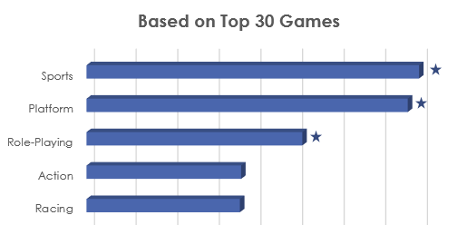
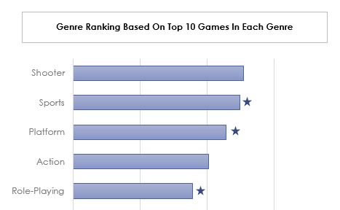
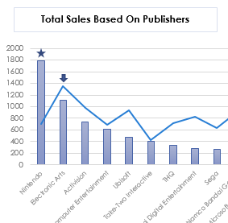
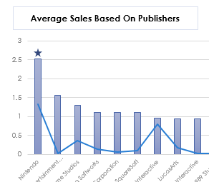
Recommendation
Genre
Sports, Shooter, Role-Playing and Platform
Perform well in both total and average sale.
Critic and User Score
Role-playing, fighting and strategy
Good review on both critic and user score
Genre : Role-playing
Publisher: Nintendo

Slide 16
Appendix
https://data.world/mhoangvslev/steam-games-dataset
https://www.commonsensemedia.org/blog/parents-ultimate-guide-to-steam#:~:text=is%20Steam%20Wallet%3F-,What%20is%20Steam%3F,and%20indie%20game%20designers%20alike.

Slide 17
Database Design and Application

Slide 18
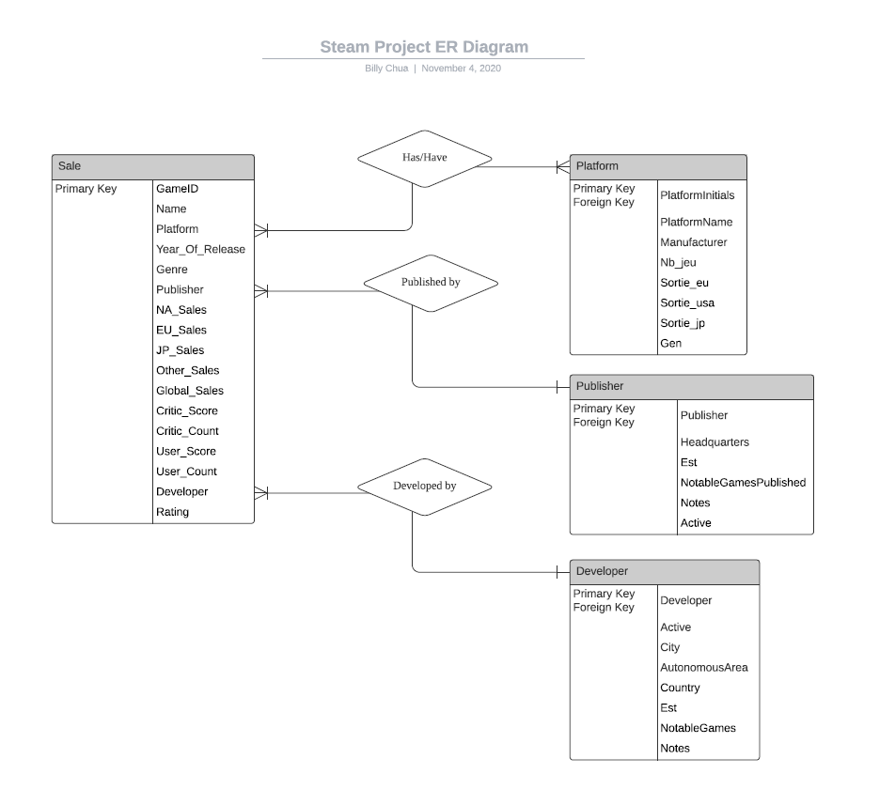

Slide 19
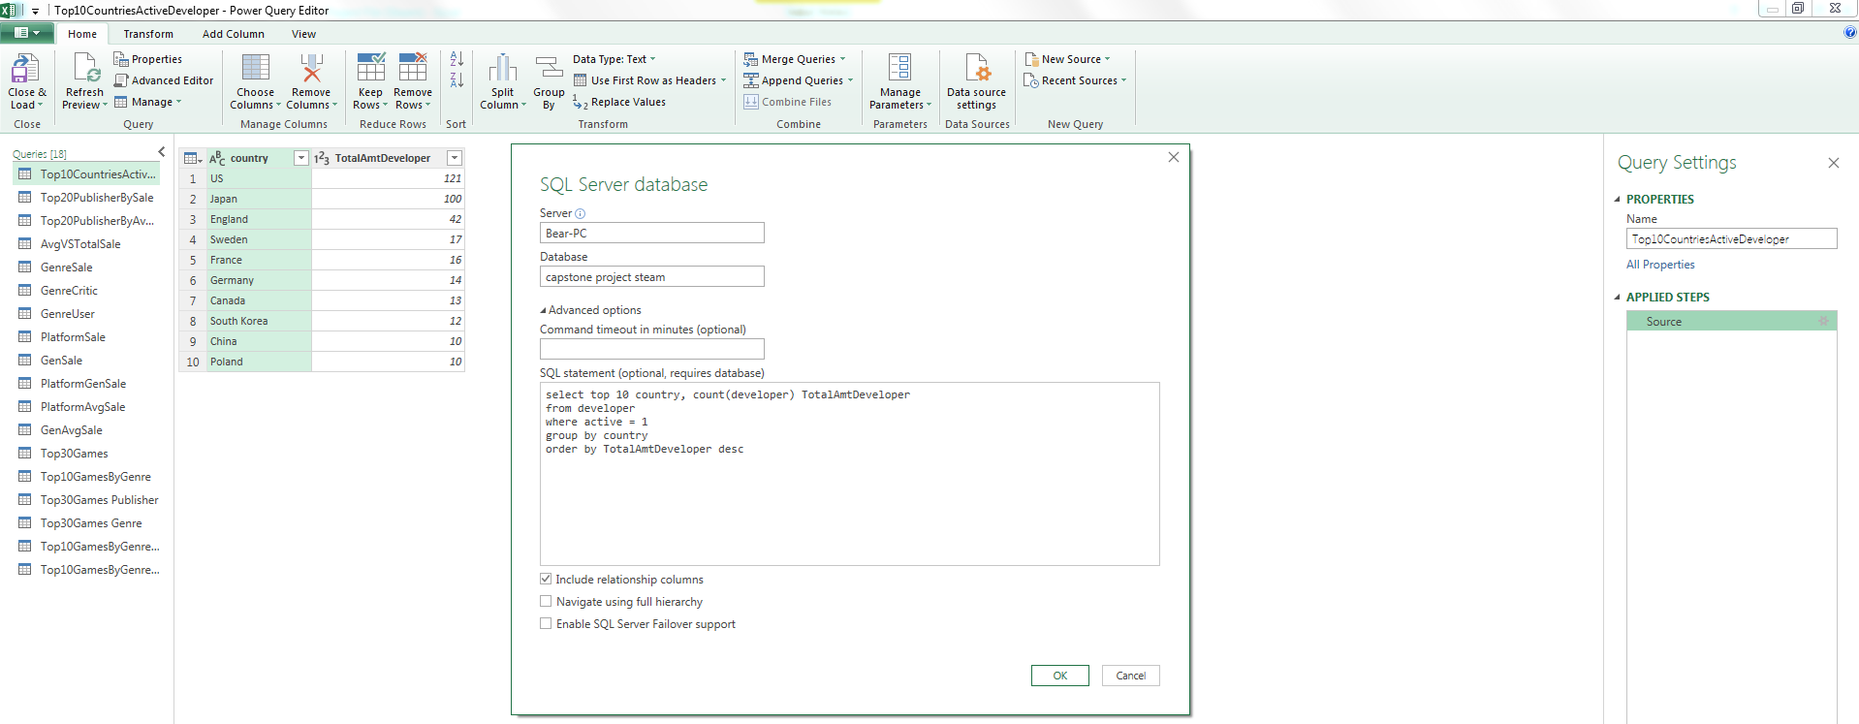
Using Excel/Power Query

Slide 20
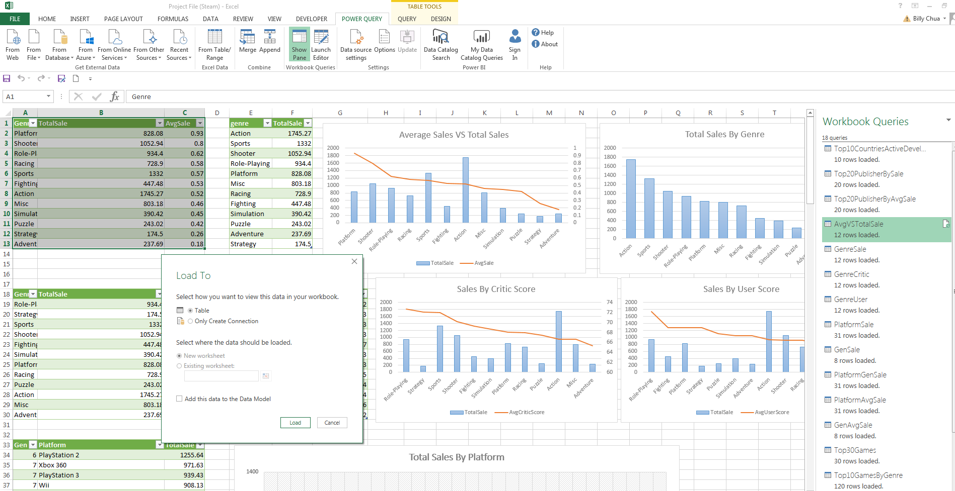
Using Excel/Power Query

Slide 21
Scripts On Data Queries
--Total Sales By Genre
select genre, round(sum(global_sales),2) TotalSale
from sale
where genre is not null
group by genre
order by TotalSale desc
--Average Sales VS Total Sales
select genre Genre, round(sum(global_sales),2) TotalSale, round(avg(global_sales),2) AvgSale
from sale
where genre is not null
group by genre
order by AvgSale desc
--Sales By Critic Score
select genre Genre, round(sum(global_sales),2) TotalSale, round(avg(critic_score),2) AvgCriticScore
from sale
where genre is not null
group by genre
order by AvgCriticScore desc
--Sales By User Score
select genre Genre, round(sum(global_sales),2) TotalSale, round(avg(user_score),2) AvgUserScore
from sale
where genre is not null
group by genre
order by AvgUserScore desc
--Total Sales By Platform
select gen Gen, nom Platform, round(sum(global_sales),2) TotalSale
from sale
join platform
on sale.platform = Initiales
group by gen, nom
order by TotalSale desc
--Total Sales By Generation
select gen Gen, round(sum(global_sales),2) TotalSale, count(distinct initiales) CountOfGen
from sale
join platform
on sale.platform = Initiales
group by gen
order by Gen asc
--Average Sale By Gen
select gen Gen, round(avg(global_sales),2) AvgSale
from sale
join platform
on sale.platform = Initiales
group by gen
order by gen asc
--Total Sales By Platform By Generation
select gen Gen, nom Platform, round(sum(global_sales),2) TotalSale
from sale
join platform
on sale.platform = Initiales
group by gen, nom
order by gen asc, TotalSale asc
--Average Sale By Platform
select gen Gen, nom Platform, round(avg(global_sales),2) AvgSale
from sale
join platform
on sale.platform = Initiales
group by gen, nom
order by AvgSale desc

Slide 22
Scripts On Data Queries
--Top Genre Based on Top 30 Games
with top30bypublisher
as
(
select top 30 genre Genre, name Gametitle, publisher Publisher, Platform, sum(global_sales) TotalSale
from sale
group by genre, name, publisher, platform
order by TotalSale desc
)
select Genre, sum(TotalSale) Top30TotalSale
from top30bypublisher
group by Genre
order by sum(TotalSale) asc
--List Of Top 10 Games Based On Genre
with GenreRanking
as
(select genre Genre, name, publisher, sum(global_sales) TotalSale,
row_number() over (partition by genre order by sum(global_sales) desc) as RowNumber
from sale
group by genre, name, publisher)
select Genre, name Gametitle, publisher Publisher, TotalSale
from GenreRanking
where rownumber <=10
and genre is not null
----List Of Top 30 Games
select top 30 genre Genre, name Gametitle, publisher Publisher, Platform, sum(global_sales) TotalSale
from sale
group by genre, name, publisher, platform
order by TotalSale desc
--Top Publisher Based on Top 30 Games
with top30bypublisher
as
(
select top 30 genre Genre, name Gametitle, publisher Publisher, Platform, sum(global_sales) TotalSale
from sale
group by genre, name, publisher, platform
order by TotalSale desc
)
select Publisher, sum(TotalSale) Top30TotalSale
from top30bypublisher
group by Publisher
order by sum(TotalSale) desc

Slide 23
Scripts On Data Queries
--Genre Ranking Based On Top 10 Games In Each Genre
with GenreRanking
as
(select genre Genre, name, publisher, sum(global_sales) TotalSale,
row_number() over (partition by genre order by sum(global_sales) desc) as RowNumber
from sale
group by genre, name, publisher)
select Genre, sum(TotalSale) Top10GenreTotalSale
from GenreRanking
where rownumber <=10
and genre is not null
group by Genre
order by Top10GenreTotalSale asc
--Publishers Ranking Based On Top 10 Games In Each Genre
with GenreRanking
as
(select genre Genre, name, publisher, sum(global_sales) TotalSale,
row_number() over (partition by genre order by sum(global_sales) desc) as RowNumber
from sale
group by genre, name, publisher)
select publisher Publisher, sum(TotalSale) Top10GenreTotalSale
from GenreRanking
where rownumber <=10
and genre is not null
group by Publisher
order by Top10GenreTotalSale asc
--Average Sales Based On Publishers
select top 20 publisher, round(avg(global_sales),2) AvgSale, count(publisher) CountOfGamePublished
from sale
group by publisher
having count(publisher) >9
order by AvgSale desc
--Total Sales Based On Publishers
select top 20 publisher, round(sum(global_sales),2) TotalSale, count(publisher) CountOfGamePublished
from sale
group by publisher
order by TotalSale desc
--Top 10 Countries On Active Developers
select top 10 country, count(developer) TotalAmtDeveloper
from developer
where active = 1
group by country
order by TotalAmtDeveloper desc

Slide 24
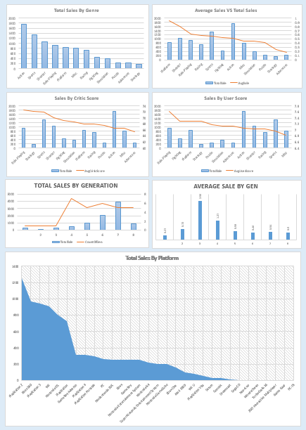
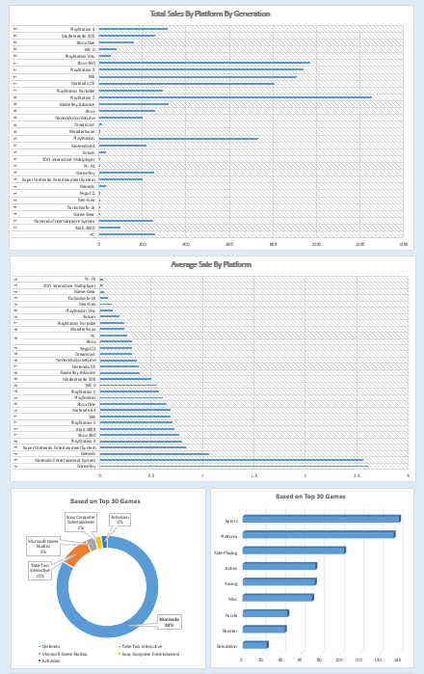
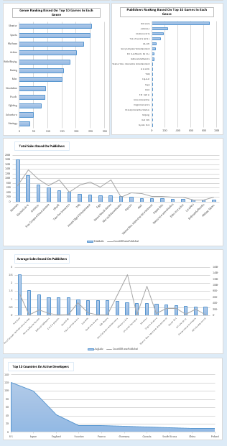
Using Excel On Building Dashboards

Slide 25
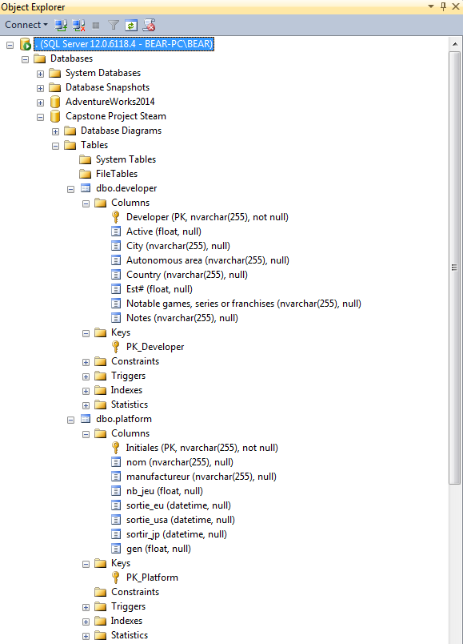
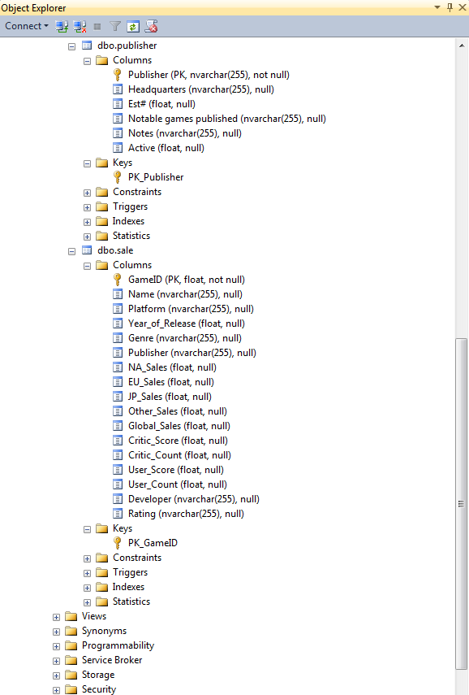

Slide 26
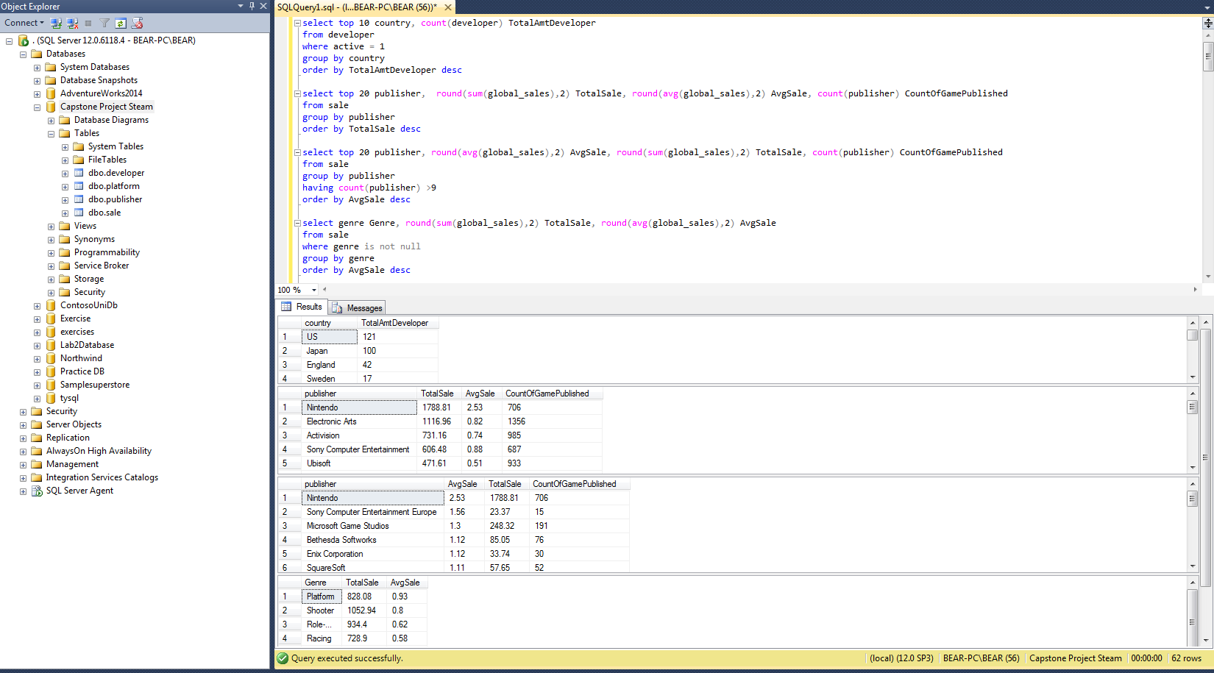

Slide 27
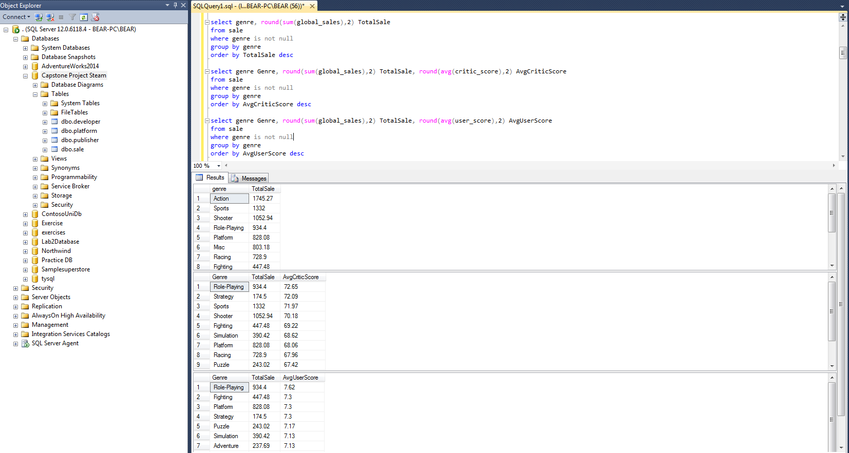

Slide 28
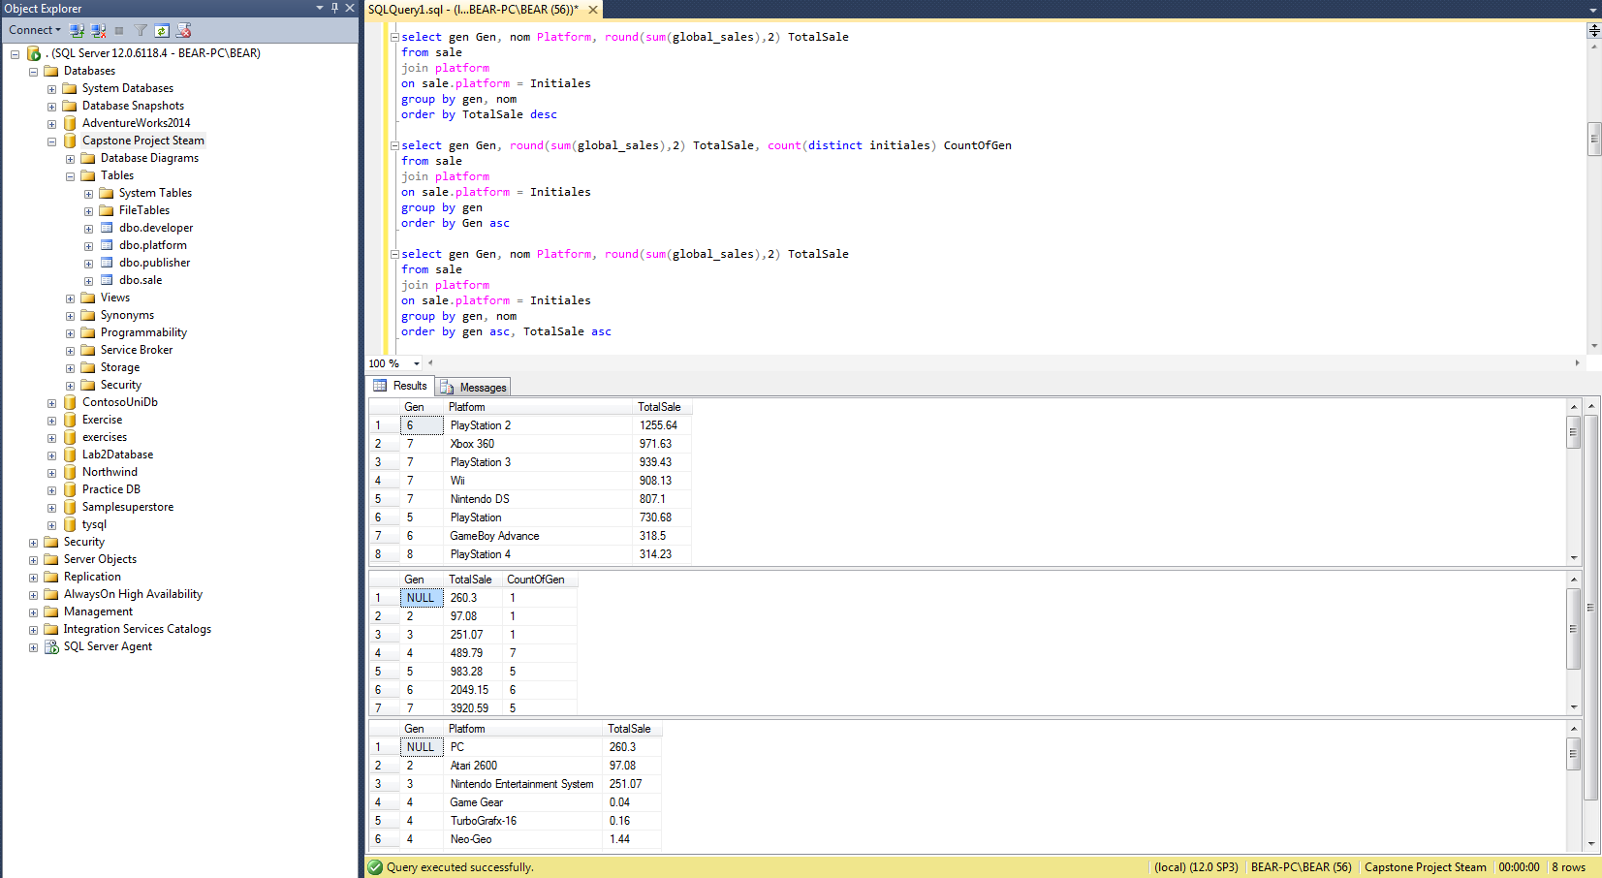

Slide 29
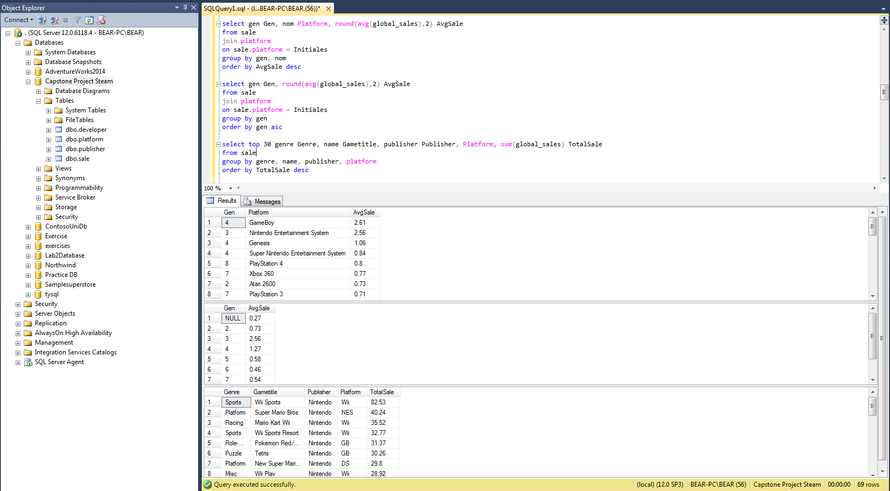

Slide 30
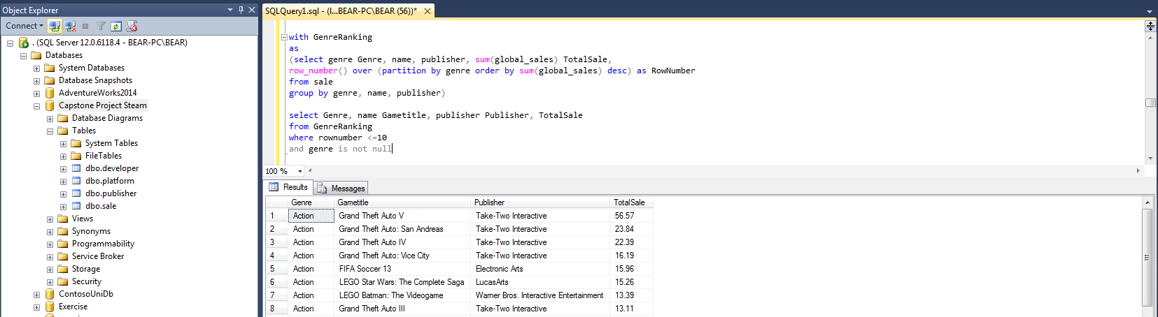
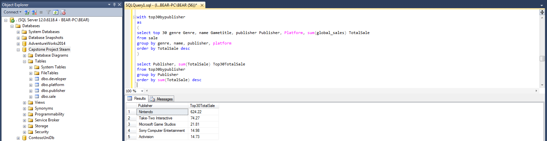

Slide 31
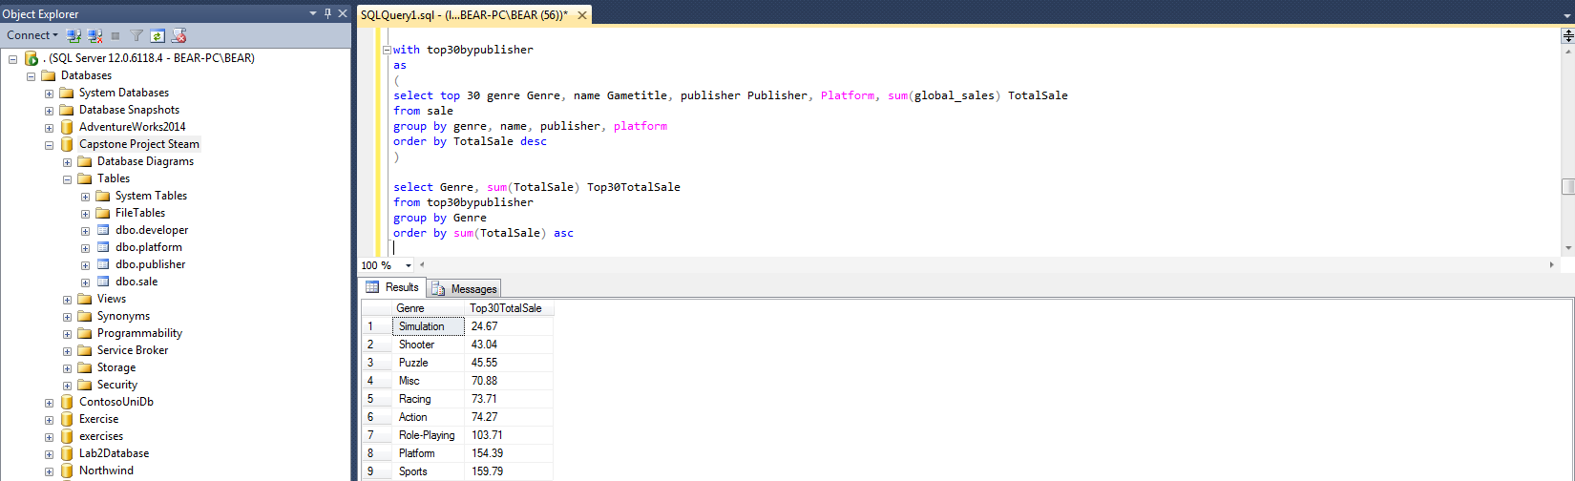
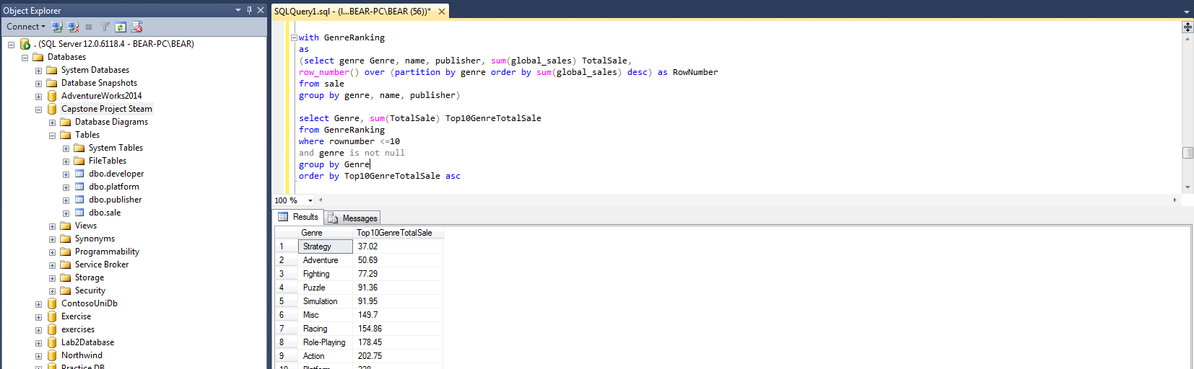

Slide 32
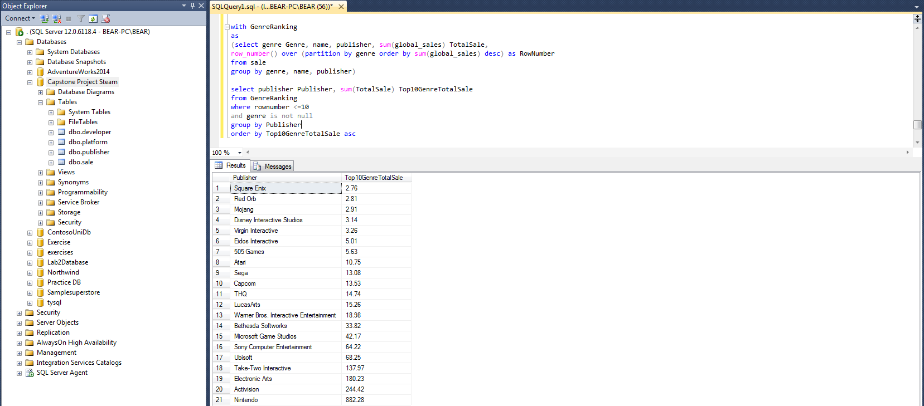

Slide 33
The End

